Slide 1

K. K. Wagh Polytechnic, Nashik. Hirabai Haridas Vidyanagari, Amrutdham, Panchavati, Nashik-422003 Department of Computer Technology
Industrial Training Summer 2023
Name of Industry: R3 System India Pvt. Ltd.
Duration: 6 weeks
Presentation By:
Name of Student: Aditya Arun Dhakane
Class: TYCM-Lin
Roll No: 15

Slide 2

Department of Computer Technology Industrial Training Summer 2023
Introduction of Industry
R3 System India Pvt. Ltd.
Establishment Year of Industry: 2017
Services / Products of Industry: Trainning of all IT Technologies, Web Design & Development, Mobile App Development, Digital Marketing, Project Consulting, Corporate Training
No. of Employees of industry: 30+ Employees
Team has more than 4-5 years of experience.

Slide 3
Department of Computer Technology Industrial Training Summer 2023
Industrial Trainer Details
Name:- Mr. Gauresh Suryawanshi Sir
Designation:- Software Developer & Project Consultant
Experience:- 4-5+ yrs. Experience
Specialization:- Web Developer
Email- gauresh.r3sys@gmail.com

Slide 4
Department of Computer Technology Industrial Training Summer 2023
Course Outline during Training
Objectives of Training: To develop specific and useful knowledge, skills and techniques.
Work performed week wise:
Weeks | Topics/ Work | Description
W1 | Software & their types. Features of Java. Identifiers. Data types & its Types. Constants. Method with different Approaches. Object Oriented Principles. Types of Members & Methods. Data Printing and Program Structure. Constructor & their Types. Wrapper Classes. This Keyword. Reading data from user. Inheritance & their types. Super Keyword. Polymorphism & their types. Method Overloading & Overriding, Data Abstraction, Data Encapsulation. Dynamic Binding. Abstract Method & Classes its types with Limitations. Etc., | Solved Assignment `s and perform various programs on the mentioned topics.

Slide 5
Department of Computer Technology Industrial Training Summer 2023
Course Outline during Training
Weeks | Topics/ Work | Description
W2 | Interface - Advantages, Syntax & Example. Packages – Purpose, Defination, Advantages. Types of Packages. List of packages. Access Modifiers. Exception handling with blocks, Errors & Exception. Multithreading. Life cycle of thread. Runnable Interface. Object Type Casting. Etc., Collecion Framework- Purpose, Defination, Advantages. Types of CF. Its Classes & Interfaces. Collection- List, Set, Map, Iterator | Solved Assignment `s and perform various programs on the mentioned topics.
W3 | JDBC Its Architecture. Steps for DataBase Connection. Loading the drivers. Interaction with DB. Servlet – Introduction, How to Create ,Development of Servlet, Life Cyc le . JSP –Intro -duction, How to Create, Life Cycle, JSP tags,Implicit Objects in JSP. | Solved Assignment `s and perform various programs on the DB Connectivity. Making Servlet & JSP pages

Slide 6
Department of Computer Technology Industrial Training Summer 2023
Course Outline during Training
Weeks | Project Work | Description
W4 | Project Topic Research Requirements Design and Architecture | Search & Finalize Project Topic : EV Charging Station Finder. Gather data and requirements on existing EV charging stations and map their locations. Create a user-friendly interface for the website.
W5 | Development & Implementation Data Integration | Execute the project plan and build the solution. Build the website module by module with features like search, updation pw, deletion and CS Approval. Develop a system to regularly update and maintain the charging station database.

Slide 7
Department of Computer Technology Industrial Training Summer 2023
Course Outline during Training
Weeks | Project Work | Description
W6 | Testing and Quality Assurance Monitoring and Evaluation Project Closure | Verify that the project meets the required standards and functionality. Also Findout any bugs,defect occurred in project and fix it properly. Continuously assess the project's performance and gather feedback from project guide. Officially close the project, evaluate its success, and learn from the experience.

Slide 8
Department of Computer Technology Industrial Training Summer 2023
Course Outline during Training
Languages/Platform/tools used: English, Java, HTML, CSS, Java Script, Eclipse IDE, MySQL, JDK 1.8, Chrome etc.,
Assignments solved:
Banking Services Console based Application
Remainder Services Console based Application
Student Record Services Console based Application
Console based Programs on basic concepts of Java

Slide 9
Department of Computer Technology Industrial Training Summer 2023
Course Outline during Training
Projects developed:
EV Charging Station Finder Website
Blood Bank Management System Website
Bank Management Services Website
Registration Form
New learning skills acquired: Working on projects, solving the technical issues, confidence buliding.
Technologies learned:
Web Designing
Web Development

Slide 10
Department of Computer Technology Industrial Training Summer 2023
Project Details implemented during Training
Title: EV Charging Station Finder
Development Platform: Eclipse IDE, JDK 1.8, MySQL server
Output Generated: Developed Website
Snapshots :

Slide 11
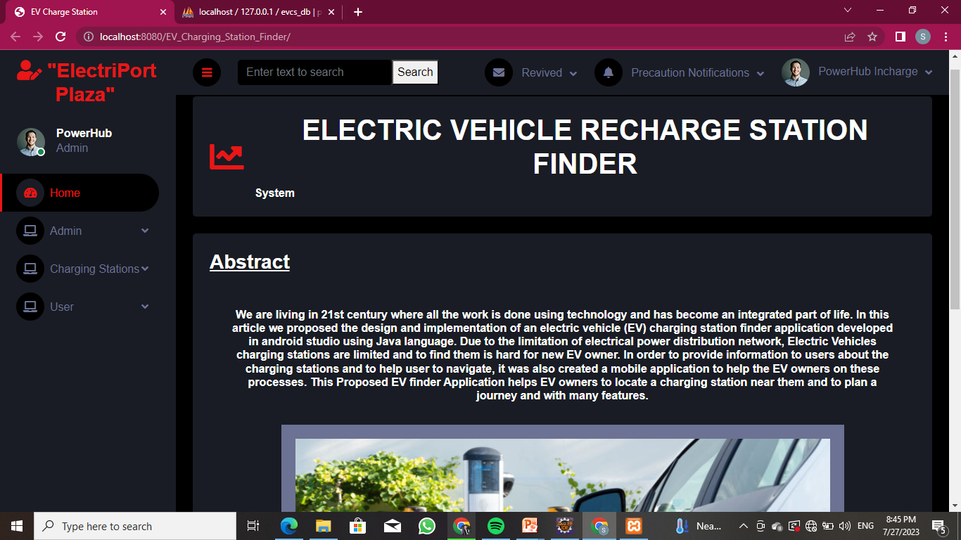
Home Page

Slide 12
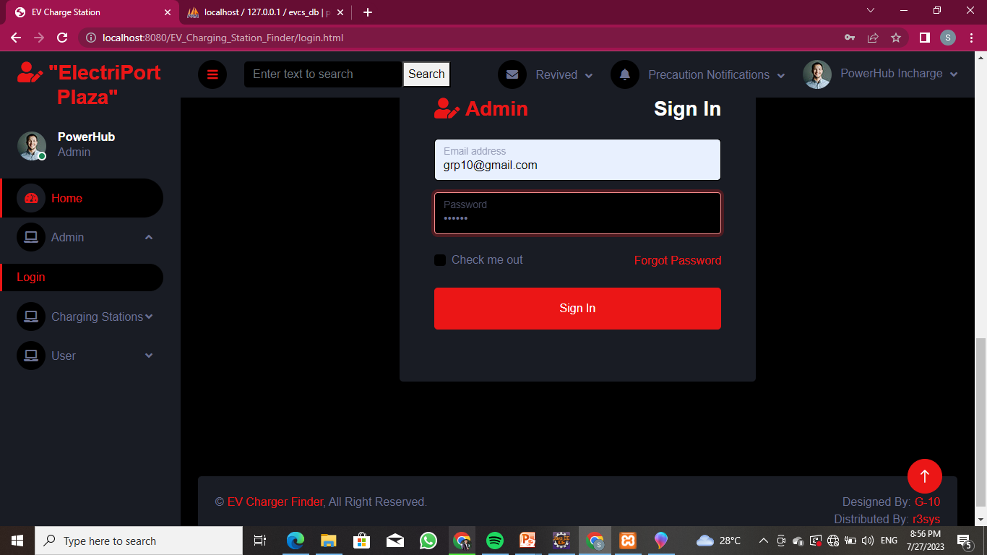
Admin Module

Slide 13
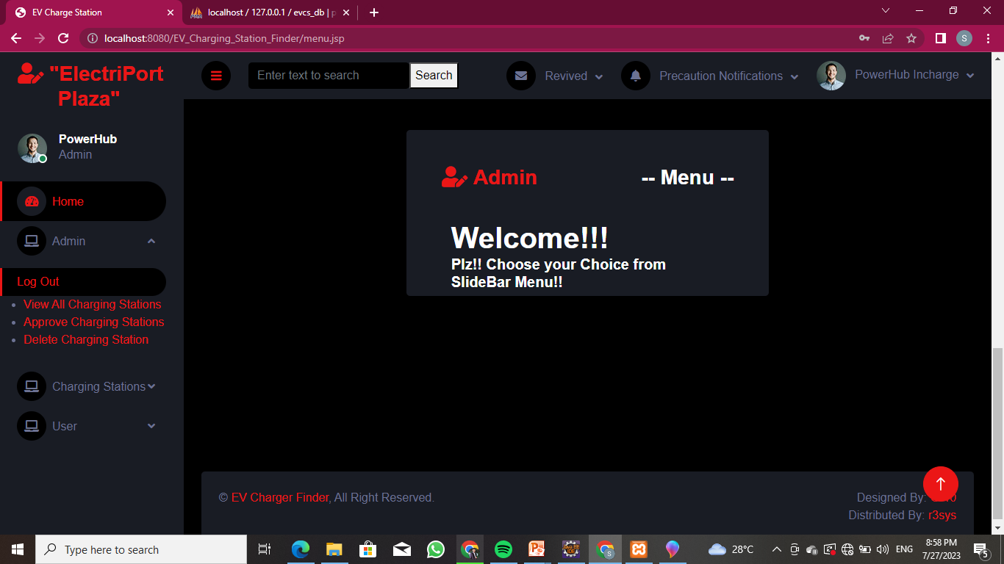
After Admin Login Shows Admin Menu

Slide 14
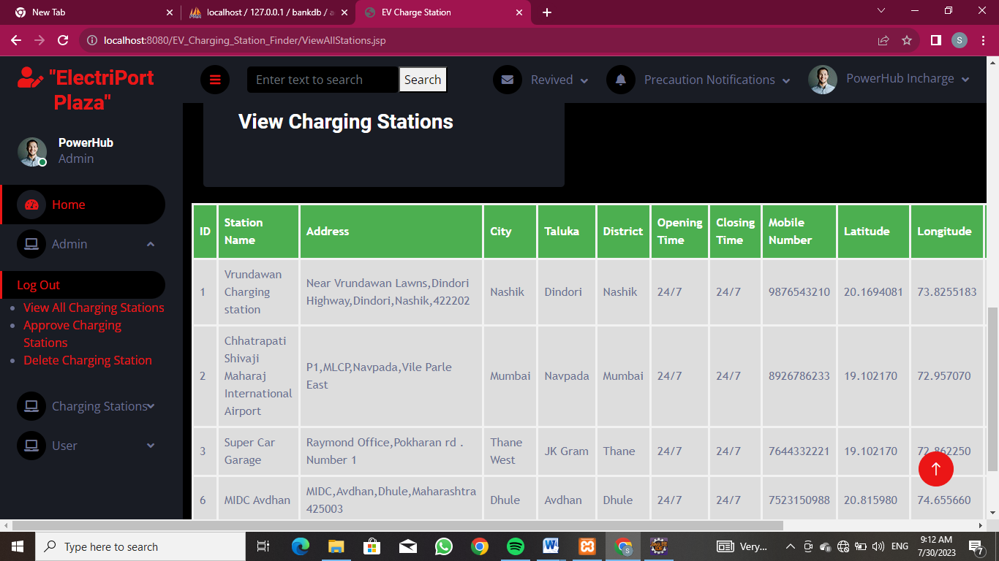
Admin Module SubMenu View All Charging Station

Slide 15
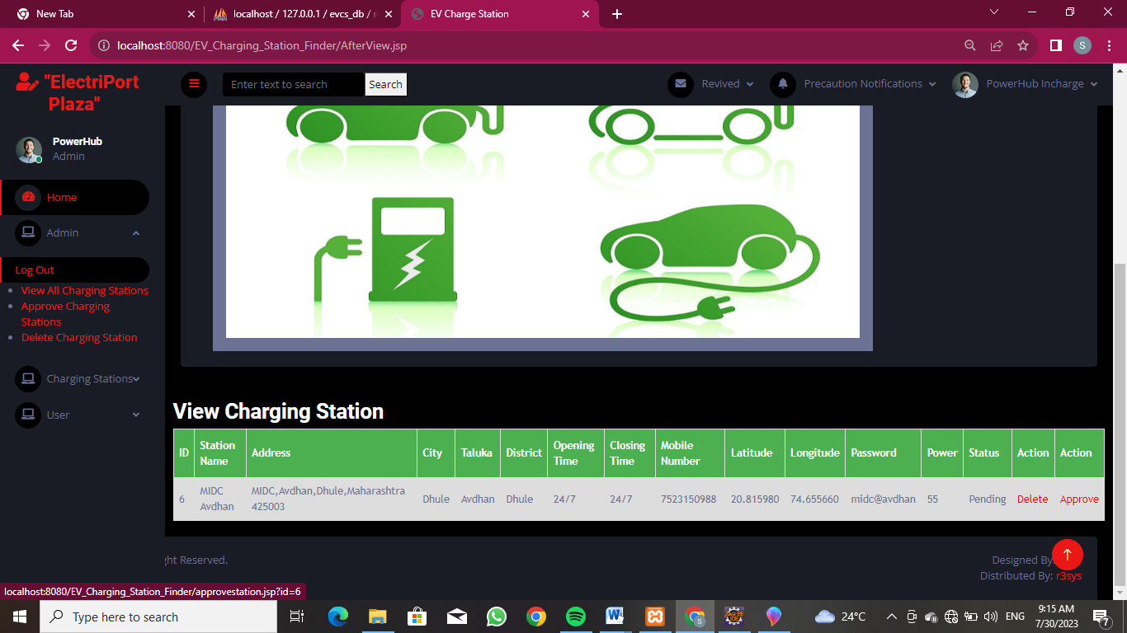
Admin Module SubMenu Approve Charging Station

Slide 16
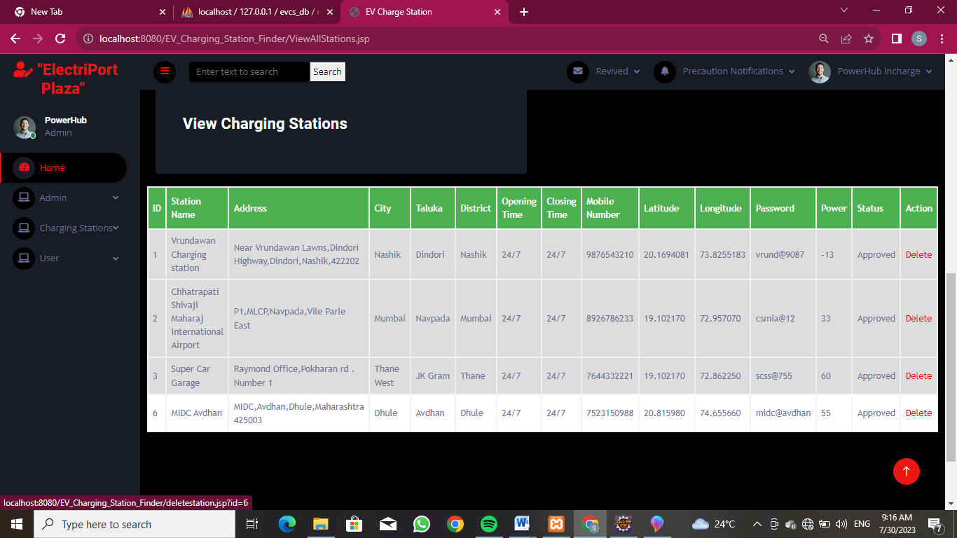
Admin Module SubMenu Delete Charging Station

Slide 17
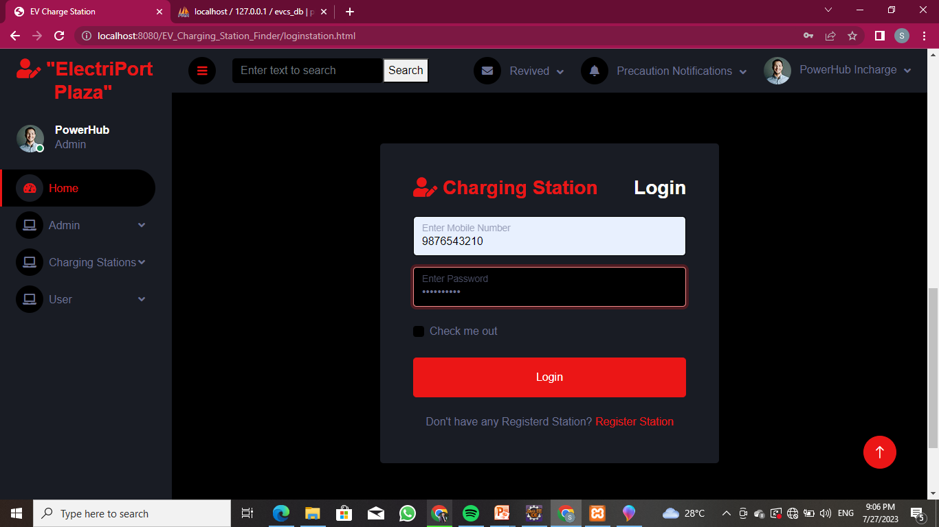
Charging Station Module

Slide 18
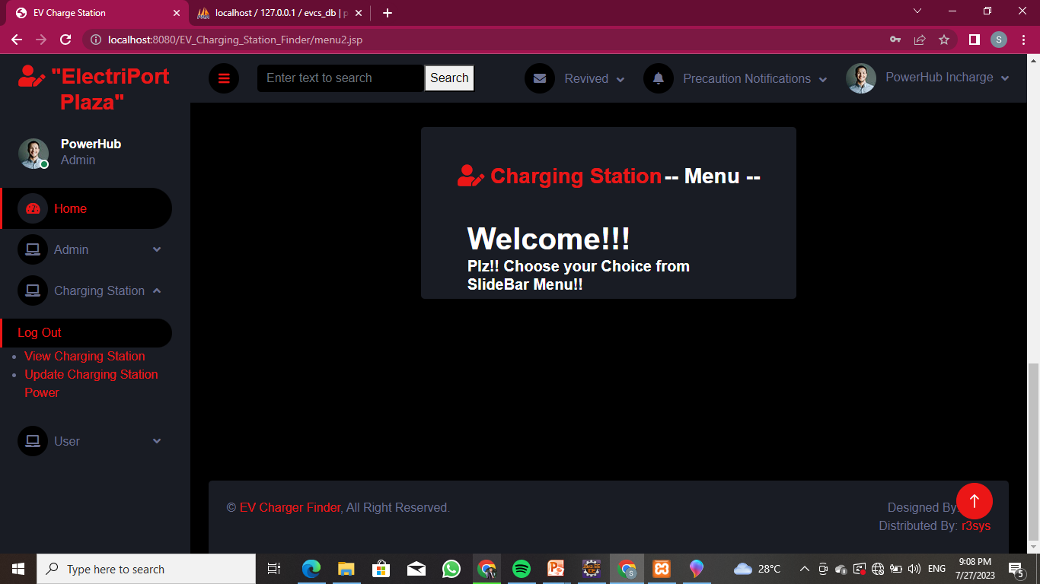
After Charging Station Login Shows Charging Station Menu

Slide 19
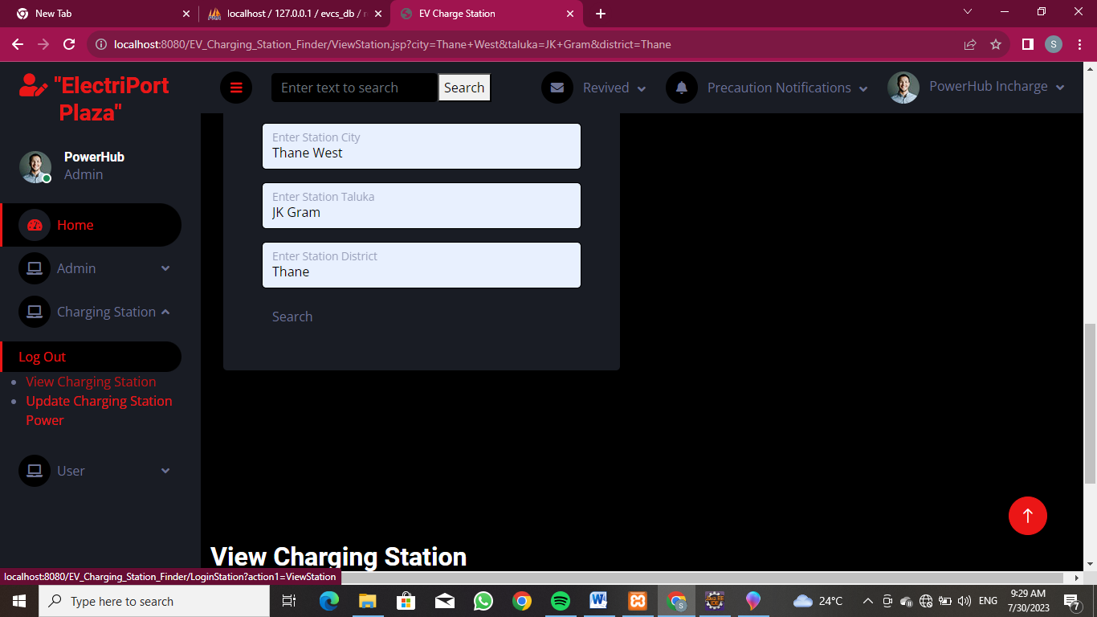
Charging Station Module SubMenu View Charging Station

Slide 20
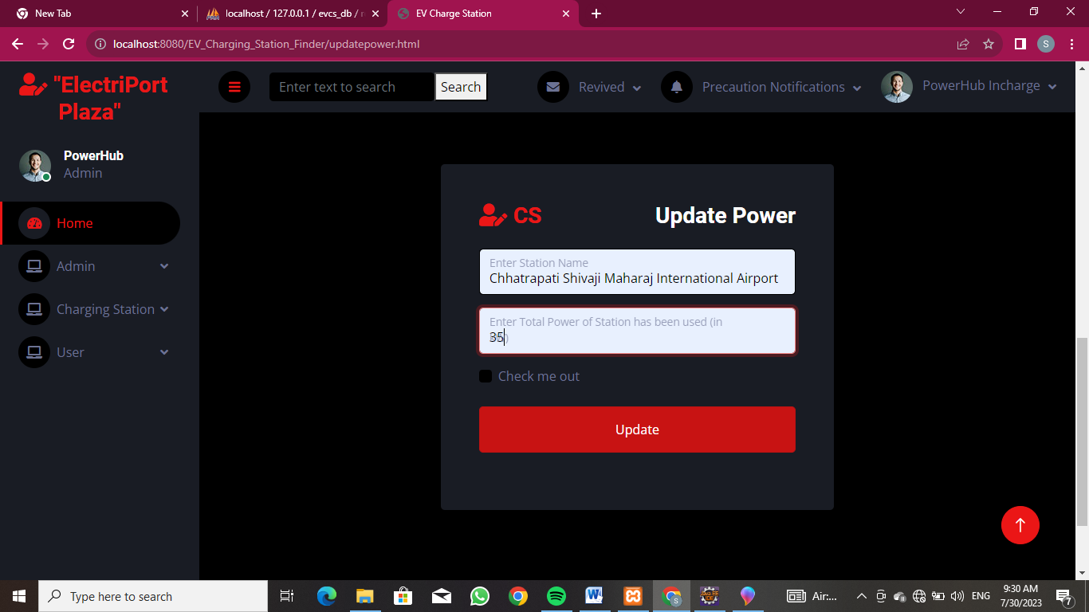
Charging Station Module SubMenu Update Charging Station Power

Slide 21
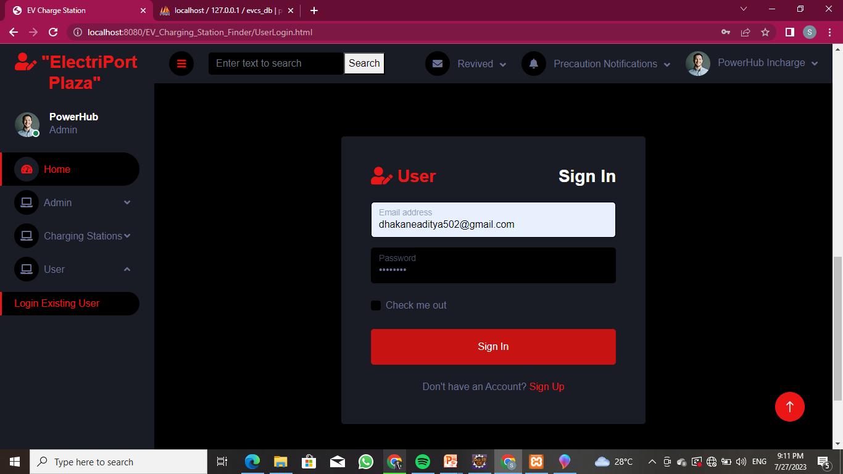
User Module

Slide 22
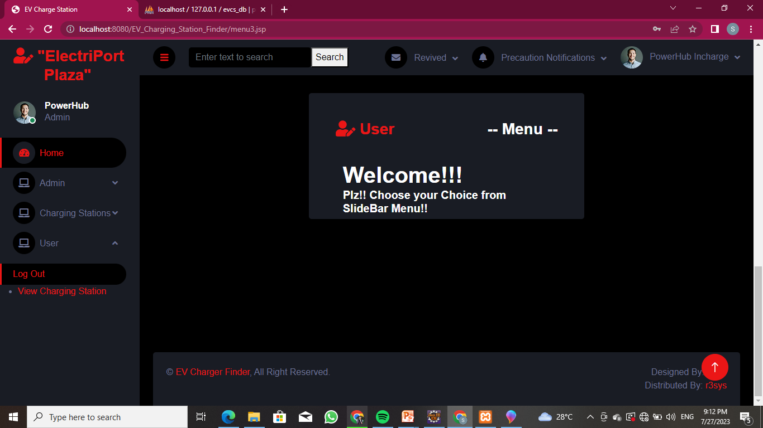
AfterUserLogin Shows User`s Menu

Slide 23
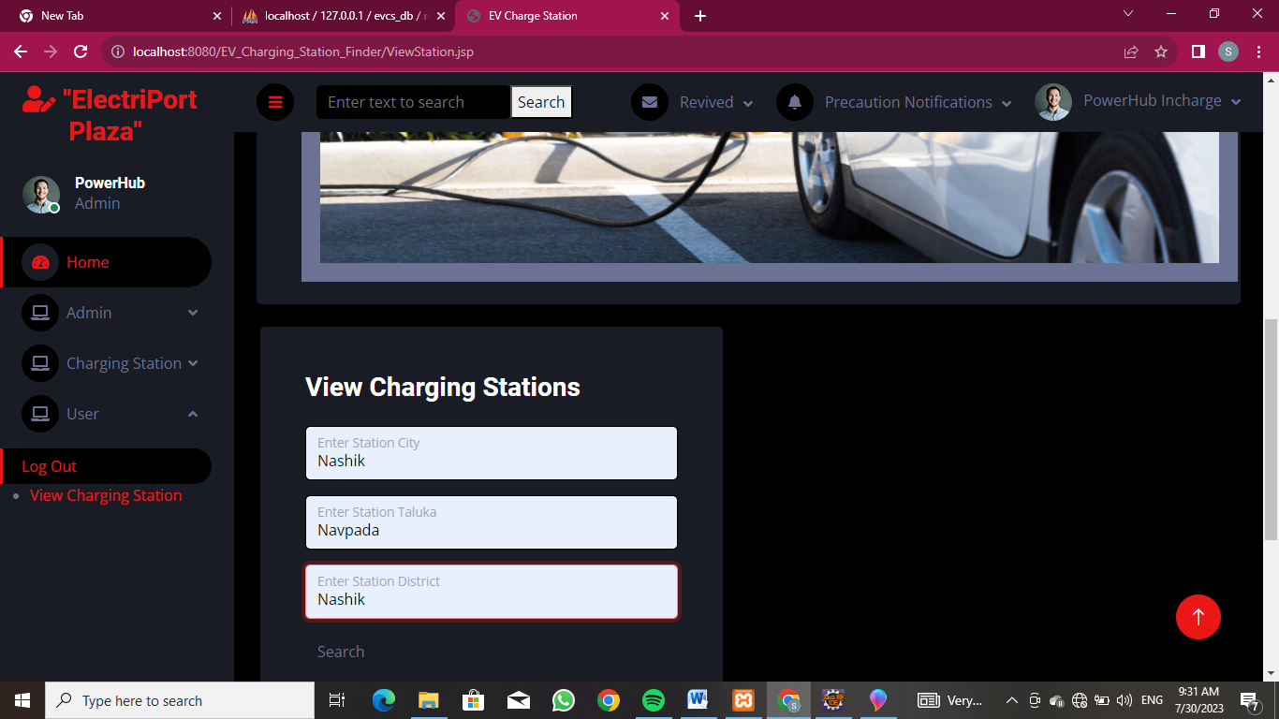
User Module SubMenu View Charging Station

Slide 24
Department of Computer Technology Industrial Training Summer 2023
References and Conclusion
List of web references taken:
https://www.w3school.com/
https://www.bootstrap.com/
https://www.r3sys.com/
https://chargefinder.com/en
https://nexonev.tatamotors.com/charging-locator/
End Result:
Learned different Languges and software’s which are
used by company to develop applications.
We learned how to make different websites.
Learned how to design project flow from client requirements.
We studied entire process of software development and its uses.

Slide 25
Department of Computer Technology Industrial Training Summer 2023
References and Conclusion
Outcome of Training:
We went through different products developed by the company and understood different features of that products.
We learned the concept of making Application and web hosting.
We saw live demonstration of Server Configuration.
We studied all services provided by R3System.

Slide 26
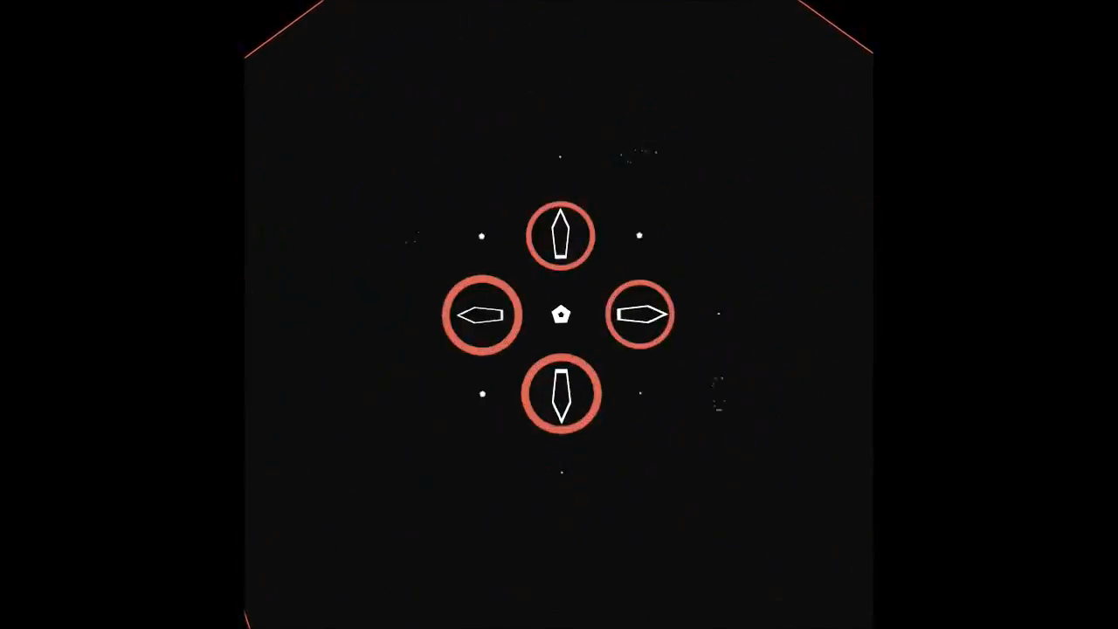
Department of Computer Technology Industrial Training Summer 2023

